Slide 1




Teleconnection Phenomena in Climate Network via Sea Surface Temperature Datasets
Daekyung Lee, Heetae Kim, Jong-Min Park, Eun Lee*

Slide 2

Correlation of climate phenomena
Introduction
Climate phenomena in various regions of the world are connected to each other
Observing inter-regional climate correlation using data such as air and ocean temperature

Slide 3
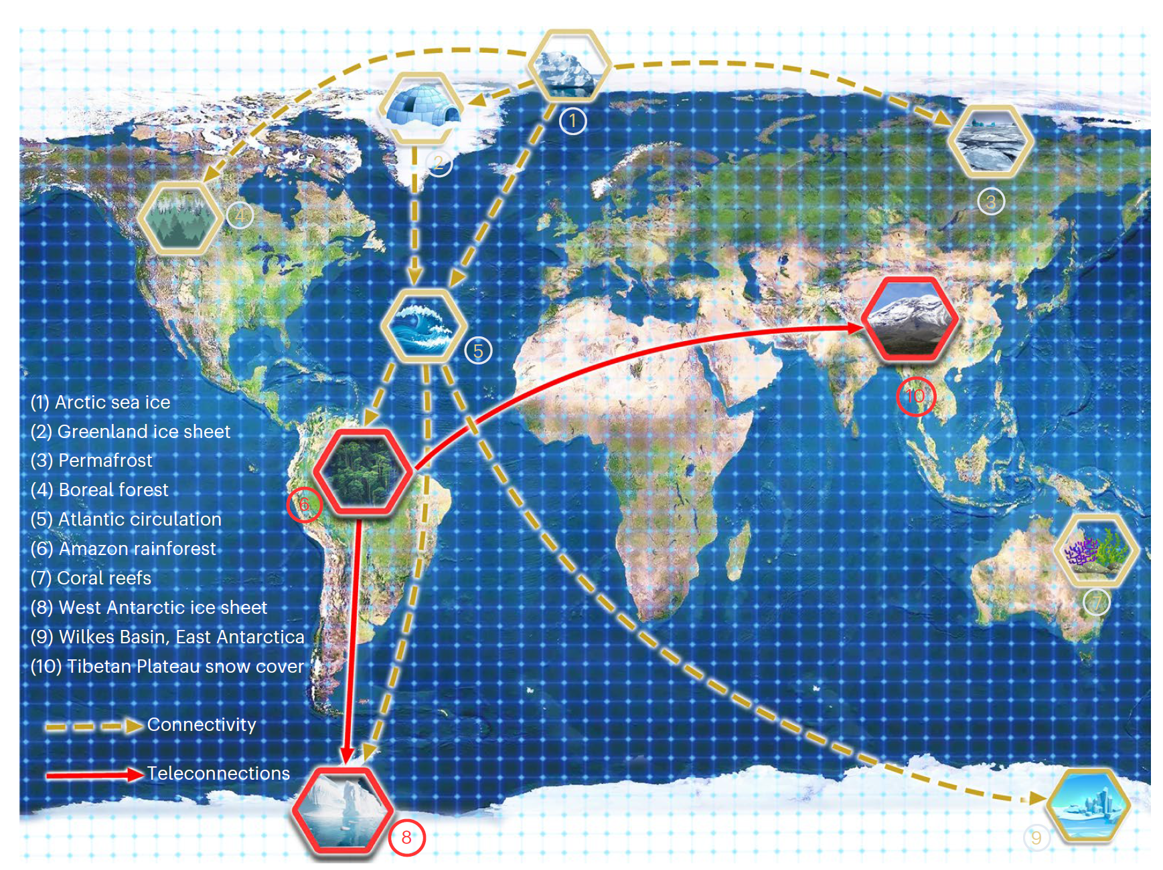
Correlation of climate phenomena
Introduction
Climate phenomena in various regions of the world are connected to each other
Observing inter-regional climate correlation using data such as air and ocean temperature

Slide 4
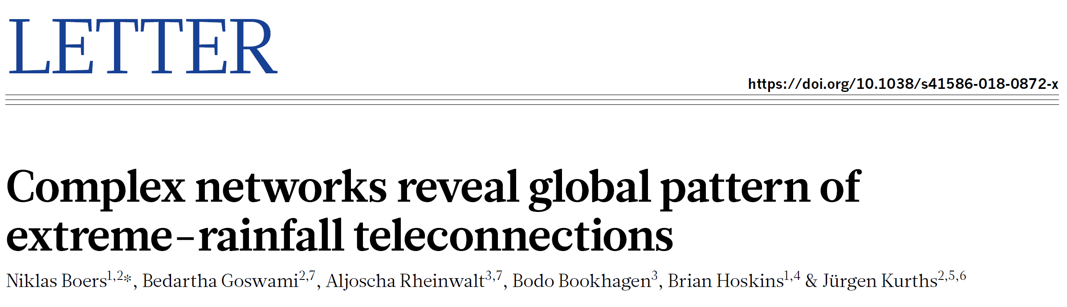
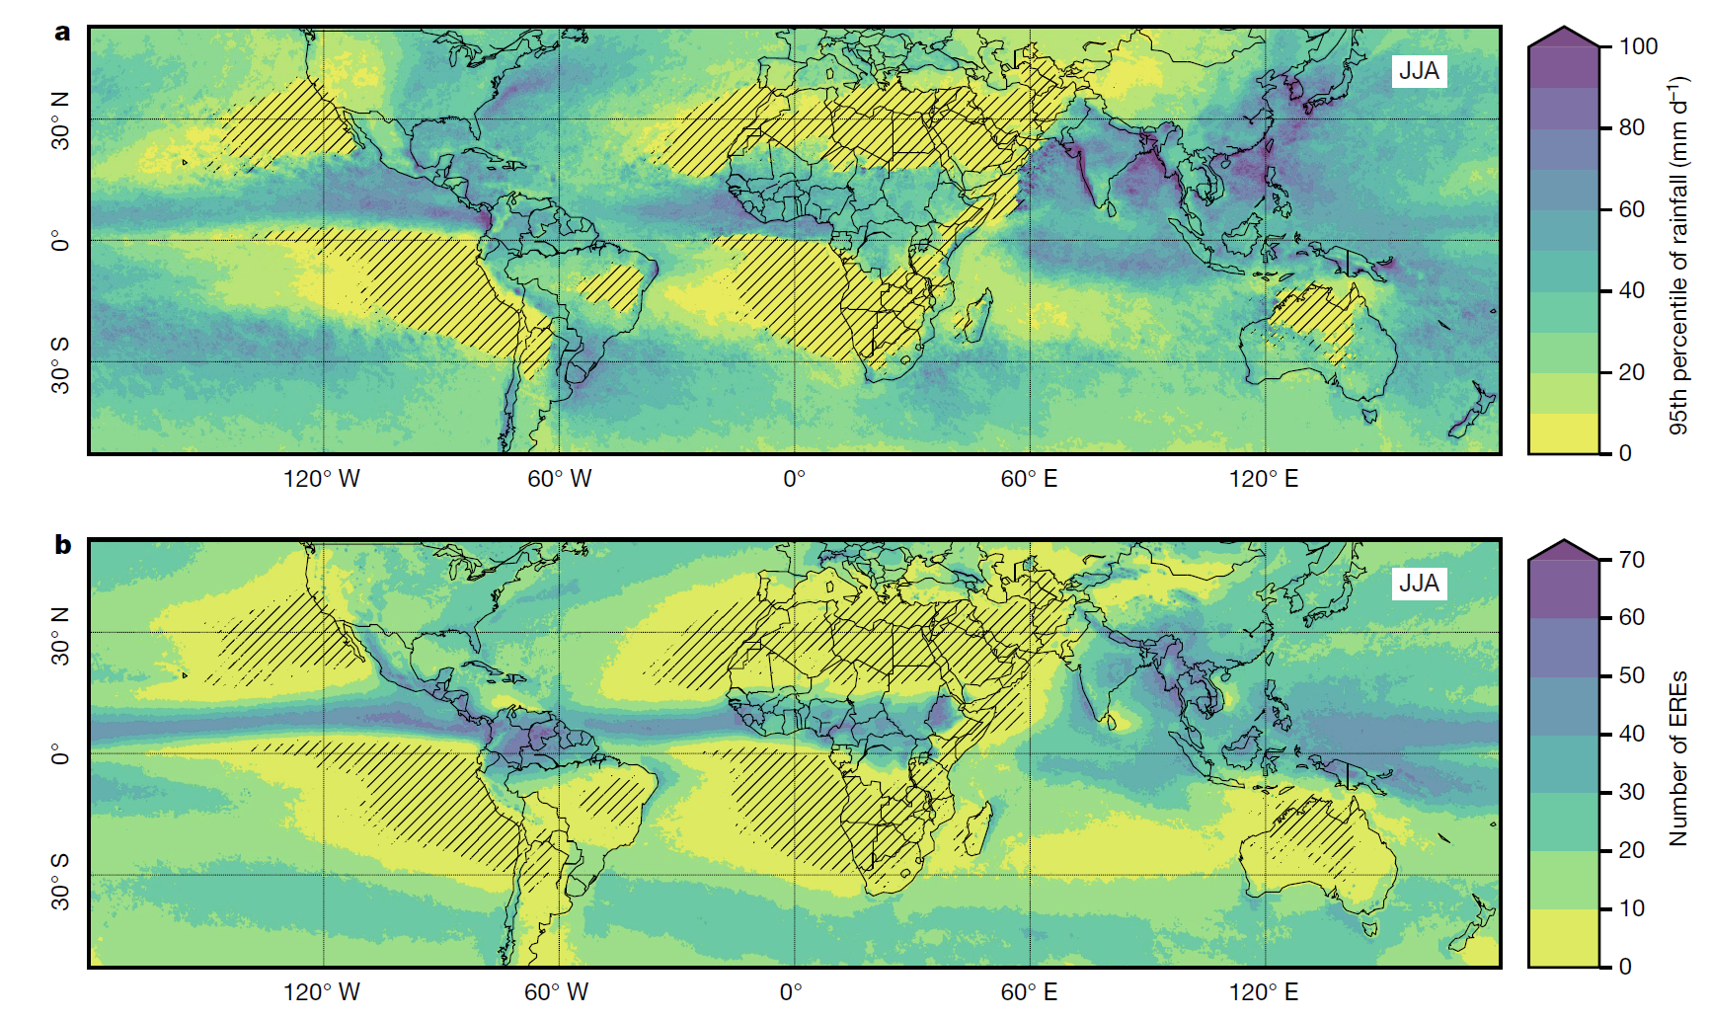
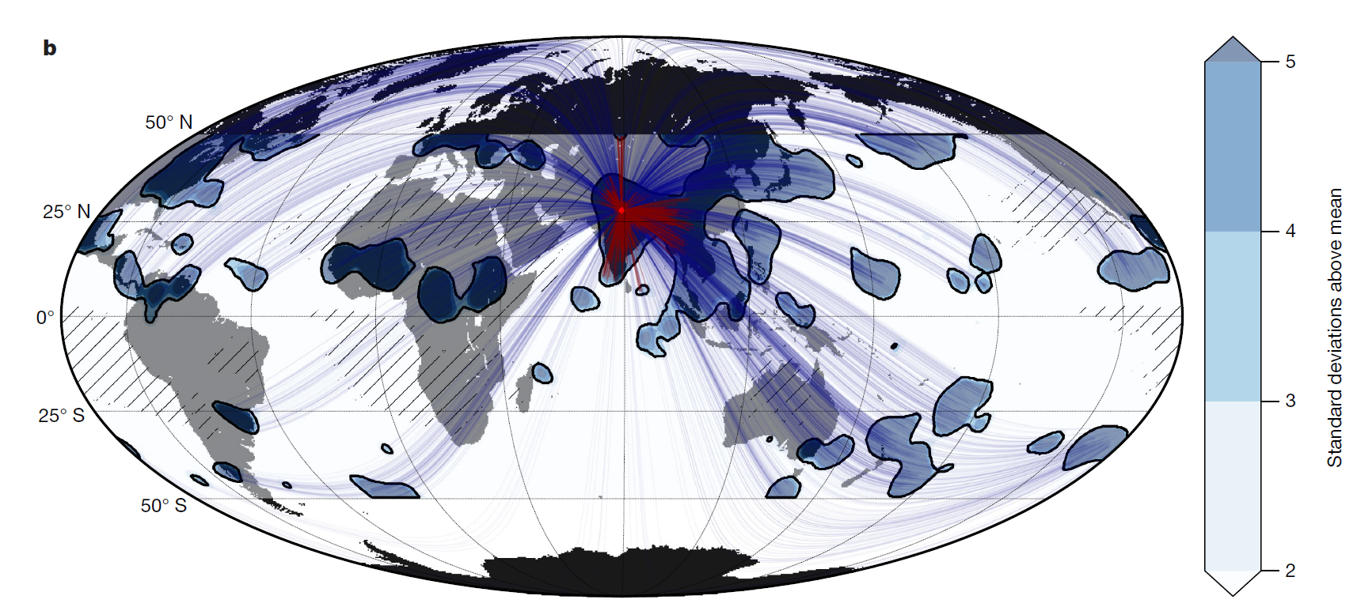
Previous researches on teleconnection
Introduction
2019 Nature paper: Observing teleconnection in global precipitation data
Synchronization analysis of intense rainfall events (ERE) where high rainfall is observed in a specific region
Inter-regional correlation is measured through the number of times EREs in two regions occur together
Many significant correlations are observed even at longer distances →Teleconnection

Slide 5
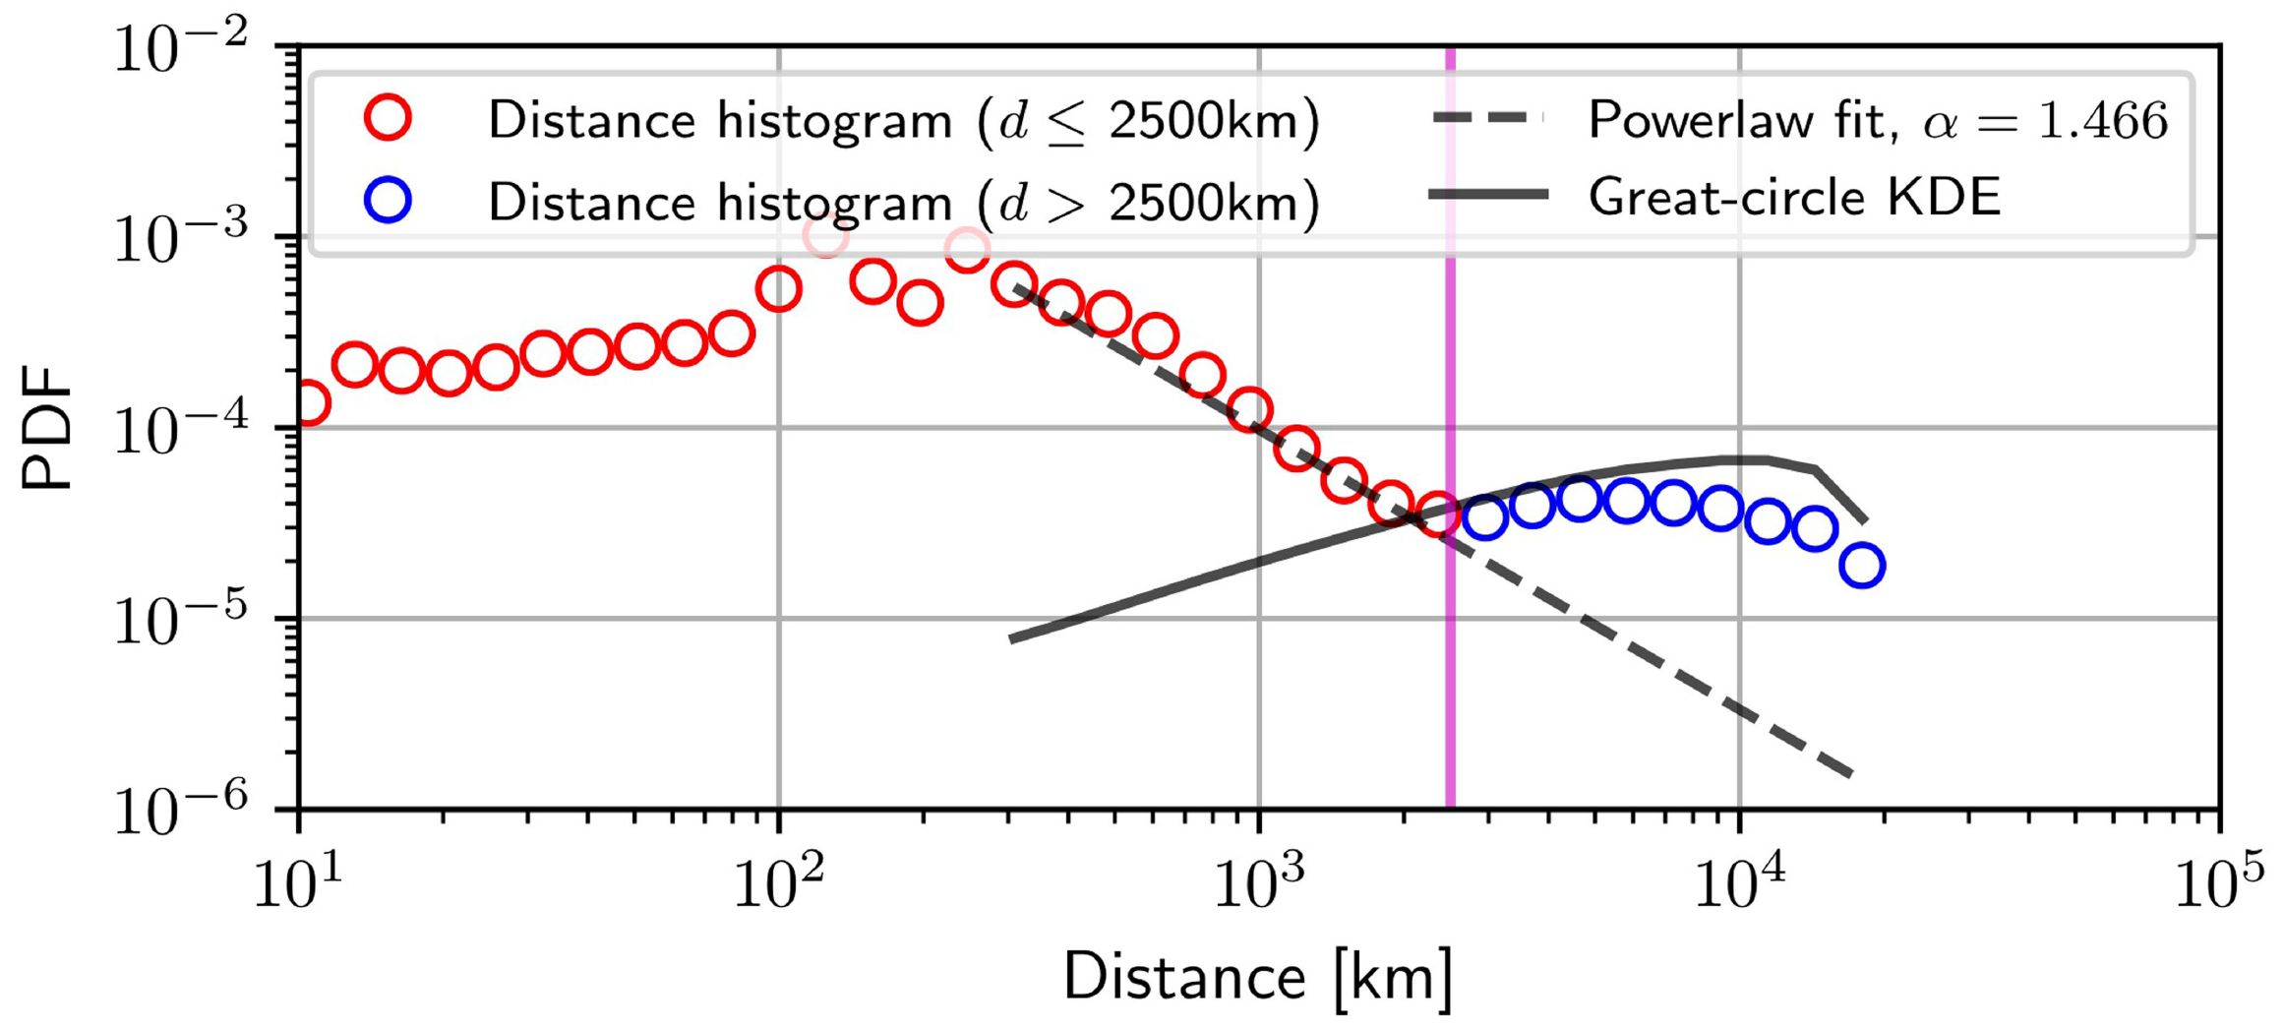
Previous researches on teleconnection
Introduction
Synchronization frequency of EREs in distant regions
The frequency of synchronization decreases as the distance increases
But increases again at the 2500 km boundary.
Teleconnection phenomenon that occurs starting at 2500 km

Slide 6
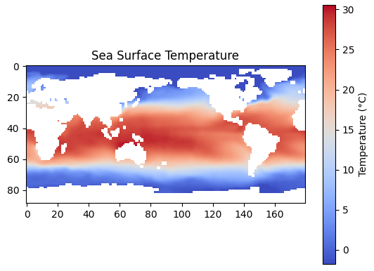
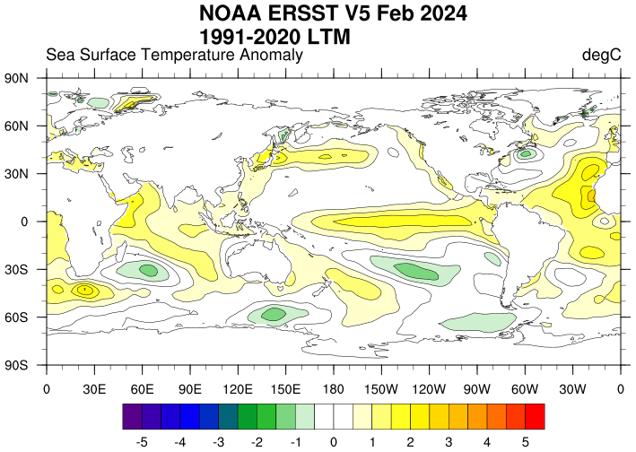
Sea-surface dataset
Dataset
Observe climate phenomena occurring in the ocean through sea surface temperature data
Data source: National Oceanic and Atmospheric Administration (NOAA).
Temperature measurement data at monthly intervals (89x180) (1854-present).
Cross-verified data based on various data accumulated through buoys, ships, etc.

Slide 7

Raw data analysis
Result
Projection onto the plane where N-dimensional points are best distinguished
T temperature data for N locations → T points in N dimensions
PCA analysis: Observe the distribution of temperature data for each location at each time
Projection onto the top two principal axes

Slide 8
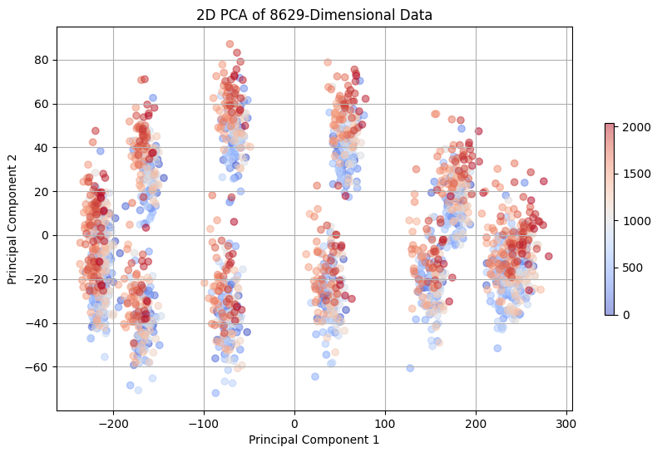
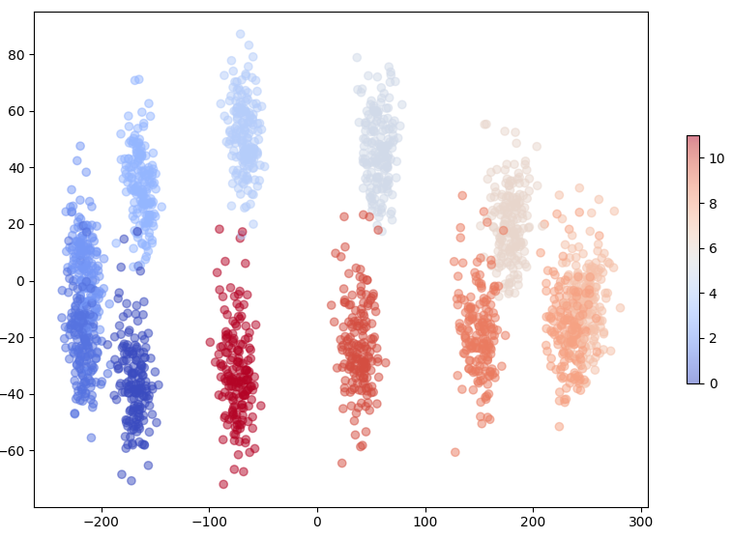
Raw data analysis
Result
Number of months elapsed
Month (0~11)
Distribution on two principal axes obtained by PCA on raw data
It is divided into 12 chunks representing each month.
As time passes, the component of the second axis increases → Global warming?

Slide 9
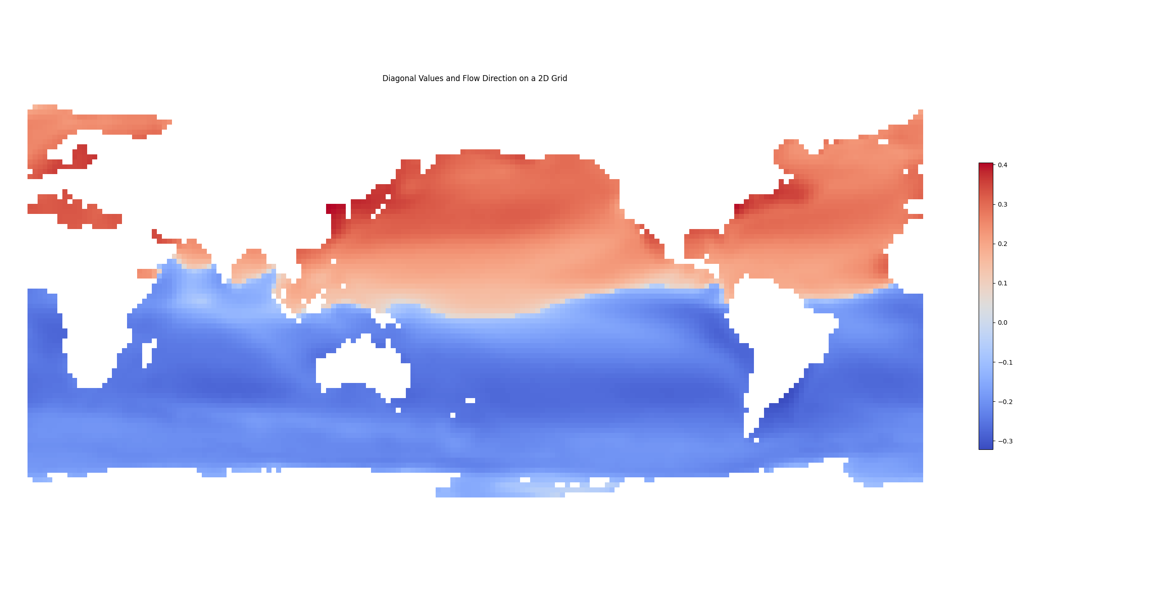
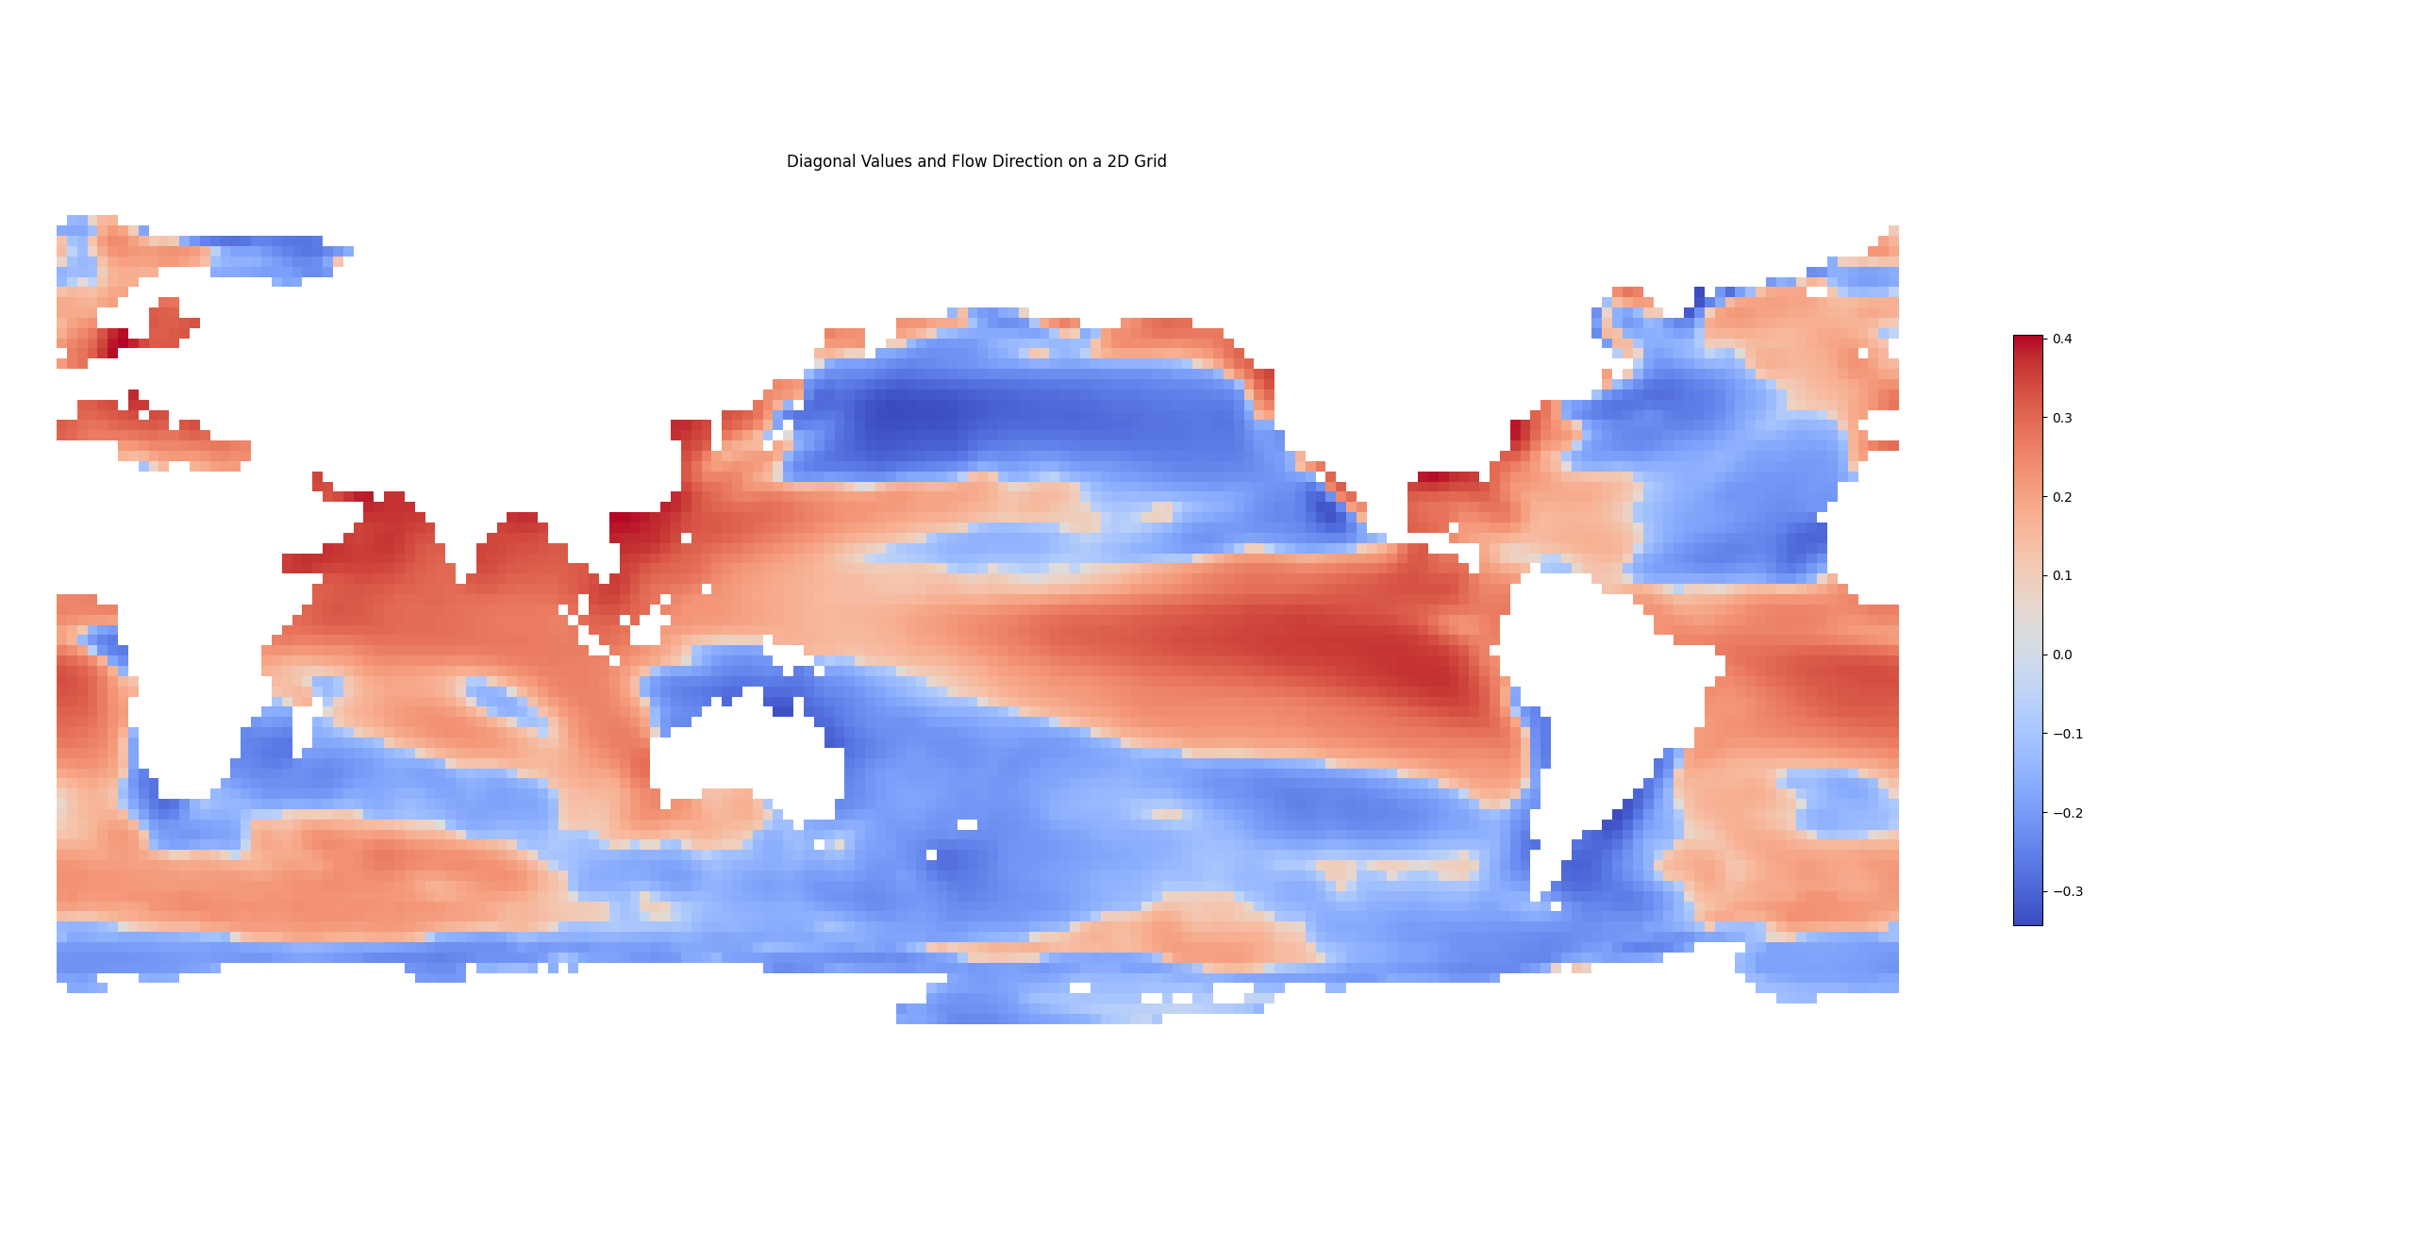
Raw data analysis
Result
1st axis
2nd axis
Top two principal component vectors from PCA analysis
First vector: Temperature patterns that help distinguish between seasons (variance contribution 0.83)
Second vector: Clusters of temperature change (0.03)

Slide 10
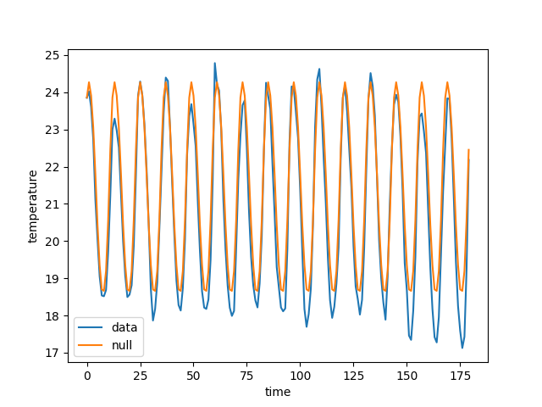
Sea-surface dataset
Dataset
Eliminates macro trends with monthly averages over the entire period for each location
Use the difference between the current data and monthly trend over the entire measurement period.
Focuses on the propagation of fluctuations at each location relative to the overall climate change pattern.

Slide 11
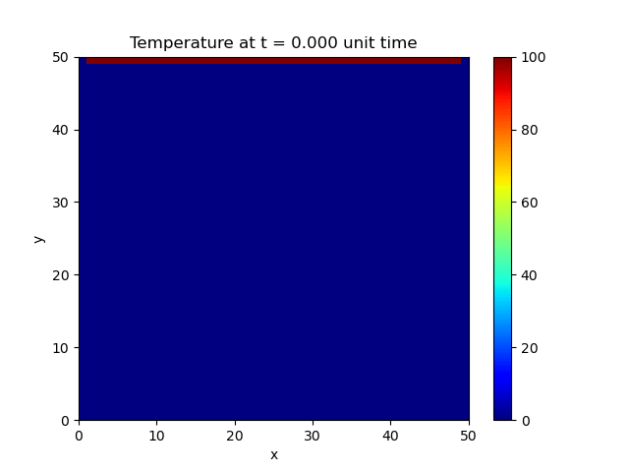
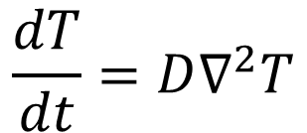
Heat equation
Method
Heat equation
thermal conductivity
$$\frac{dT}{dt}=D∇^{2}T$$
Temperature difference from surrounding area
The temperature in your area changes
Approach the relationship between sea surface temperature changes using the heat equation
The temperature of each point changes depending on the temperature difference from surrounding points.

Slide 12
Heat equation
Method
Heat equation
Ex) Temperature changes in the network
thermal conductivity
$$\frac{dT}{dt}=D∇^{2}T$$
2
Initial Temperature:3
Thermal conductivity: 0.5
Temperature difference from surrounding area
3
The temperature change of target point
1
Application of heat equation to network structure
The center follows the temperature of surrounding nodes.

Slide 13
Heat equation
Method
Heat equation
Ex) Temperature changes in the network
thermal conductivity
$$\frac{dT}{dt}=D∇^{2}T$$
2
Initial Temperature:3
Thermal conductivity: 0.5
Temperature difference from surrounding area
1.5
Temperature difference: (2-3) = -1
Impact: -1 Ⅹ 0.5 = -0.5
The temperature change of target point
1
Temperature difference: (1-3) = -2
Impact: -2 Ⅹ 0.5 = -1
Application of heat equation to network structure
The center follows the temperature of surrounding nodes.
Total temperature change: -1.5
The temperature difference is reflected as much as the thermal conductivity of the target node.

Slide 14
Heat equation
Method
Heat equation
Ex) Temperature changes in the network
thermal conductivity
$$\frac{dT}{dt}=D∇^{2}T$$
2
Initial Temperature:3
Thermal conductivity: 0.5
Temperature difference from surrounding area
1.5
Temperature difference: (2-3) = -1
Impact: -1 Ⅹ 0.5 = -0.5
The temperature change of target point
1
Temperature difference: (1-3) = -2
Impact: -2 Ⅹ 0.5 = -1
However, in sea surface temperature, the conductivity may vary depending on the direction
Introducing a general heat equation that relaxes symmetry

Slide 15
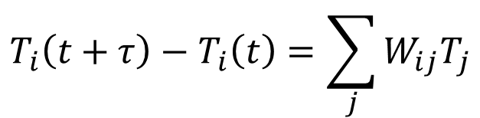
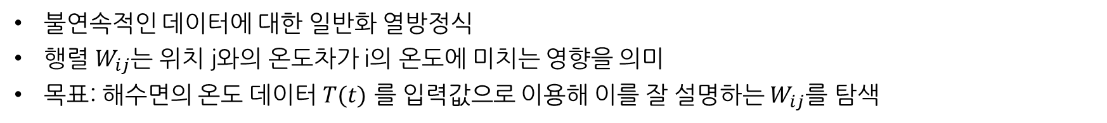
Heat equation
Method
Heat equation
Generalized heat equation
thermal conductivity
$$\frac{dT}{dt}=D∇^{2}T$$
$$T_{i}\left(t+τ\right)−T_{i}\left(t\right)=\sum_{j}{W_{ij}T_{j}}$$
Temperature difference from surrounding area
Generalized interaction matrix
(influence of position j on i)
The temperature change of target point
Temperature at location j at time t
불연속적인 데이터에 대한 일반화 열방정식
행렬 $W_{ij}$는 위치 j와의 온도차가 i의 온도에 미치는 영향을 의미
목표: 해수면의 온도 데이터 $T(t)$ 를 입력값으로 이용해 이를 잘 설명하는 $W_{ij}$를 탐색
Notes:
폰트크기 맞

Slide 16
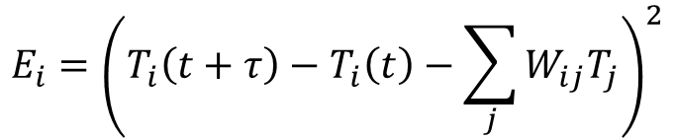
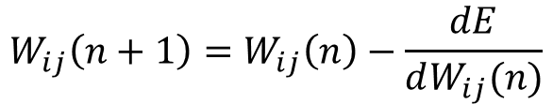
Heat equation
Method
Generalized heat equation
$$E_{i}={\left(T_{i}\left(t+τ\right)−T_{i}\left(t\right)−\sum_{j}{W_{ij}T_{j}}\right)}^{2}$$
$$T_{i}\left(t+τ\right)−T_{i}\left(t\right)=\sum_{j}{W_{ij}T_{j}}$$
Generalized interaction matrix
(influence of position j on i)
actual temperature change
predicted value
$$W_{ij}\left(n+1\right)=W_{ij}\left(n\right)−\frac{dE}{dW_{ij}(n)}$$
Temperature at location j at time t
Take the square of the difference between both sides as the error function
Searching for W that minimizes this error function.
Initialize and update the W matrix appropriately to minimize the error.
Allows correlation between all locations, even if they are not close

Slide 17
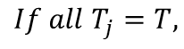
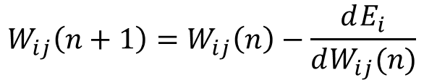
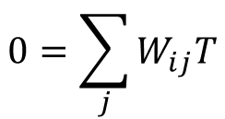
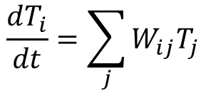
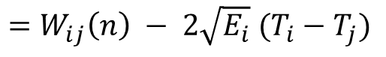

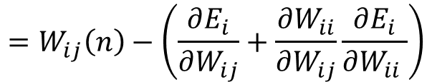

Heat equation
Method
$$E_{i}={\left(T_{i}\left(t+τ\right)−T_{i}\left(t\right)−\sum_{j}{W_{ij}T_{j}}\right)}^{2}$$
$$\frac{dT_{i}}{dt}=\sum_{j}{W_{ij}T_{j}}$$
Update $W_{ij}$ such that E decreases
$$If all T_{j}=T,$$
$$W_{ij}\left(n+1\right)=W_{ij}\left(n\right)−\frac{dE_{i}}{dW_{ij}(n)}$$
$$0=\sum_{j}{W_{ij}T}$$
$$=W_{ij}\left(n\right)−\left(\frac{∂E_{i}}{∂W_{ij}}+\frac{∂W_{ii}}{∂W_{ij}}\frac{∂E_{i}}{∂W_{ii} }\right)$$
$$=W_{ij}\left(n\right) − 2\sqrt{E_{i}} (T_{i}−T_{j})$$
Secondary change ($W_{ij}→W_{ii}→E)$
Take the square of the difference between both sides as the error function
Searching for W that minimizes this error function.
Initialize and update the W matrix appropriately to minimize the error.
Allows correlation between all locations, even if they are not close

Slide 18
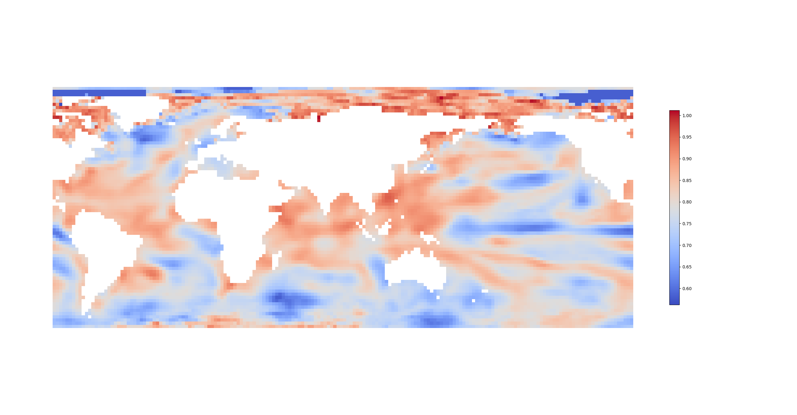
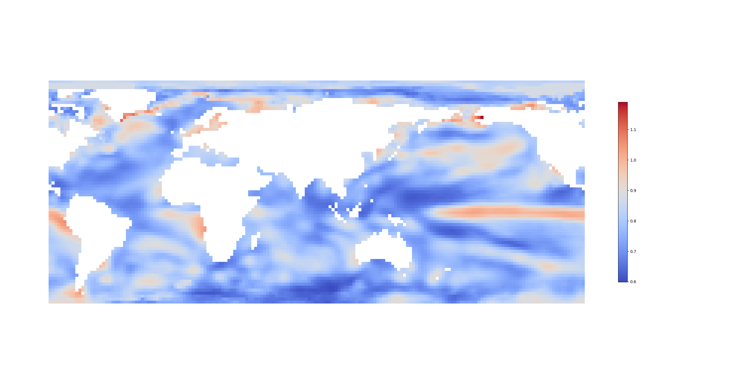
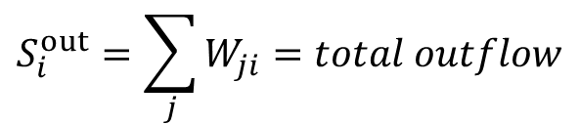
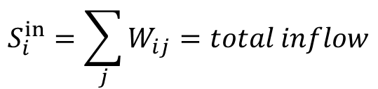
Flow analysis
Result
$$S_{i}^{in}=\sum_{j}{W_{ij}}=total inflow$$
$$S_{i}^{out}=\sum_{j}{W_{ji}}=total outflow$$
Influence of each region achieved through optimization
Left: Total influence (sensitivity) from temperatures in other regions
Right: Total influence on temperature of different regions

Slide 19
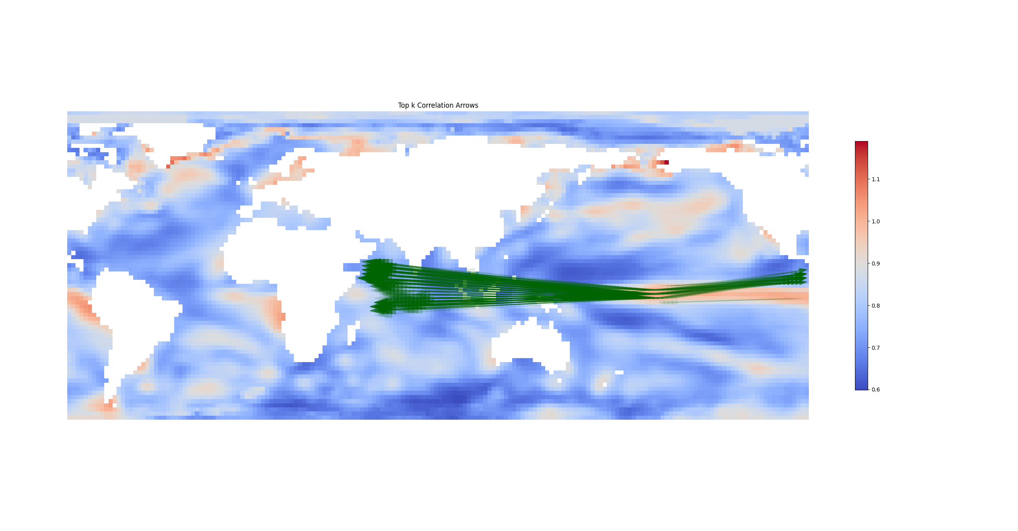
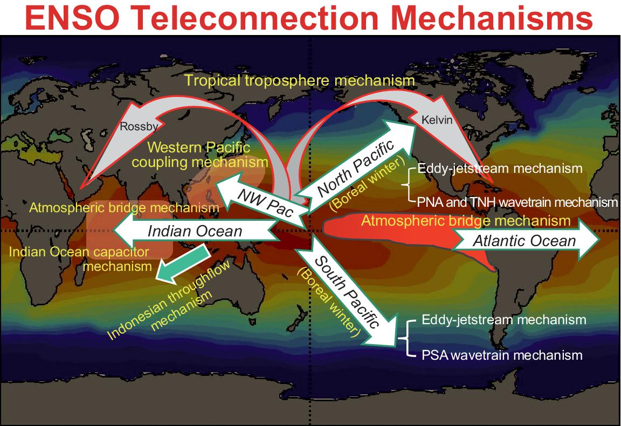
Flow analysis
Result
$$S_{i}^{in}=\sum_{j}{W_{ij}}=total inflow$$
$$S_{i}^{out}=\sum_{j}{W_{ji}}=total outflow$$
Influence of each region achieved through optimization
Left: Total influence (sensitivity) from temperatures in other regions
Right: Total influence on temperature of different regions
Similar to the ENSO pattern found in existing climate-related studies
Notes:
ㄱ

Slide 20
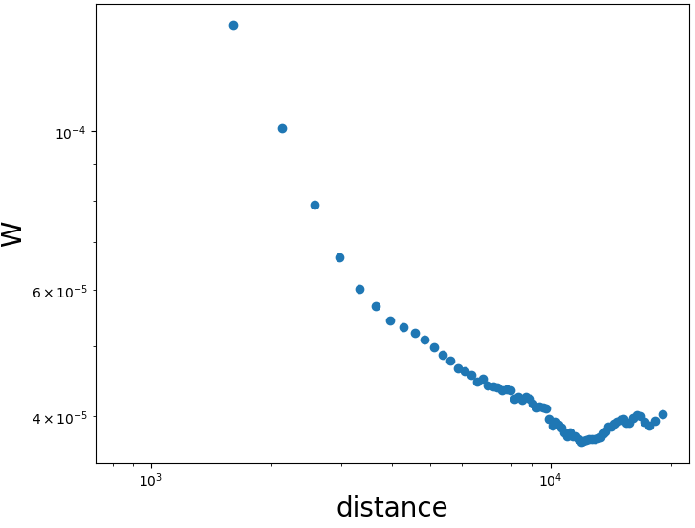
Flow analysis
Result
Change of W as a function of distance
It changes slightly from around 4,000km and rebounds above 10,000km.
Consistent with other researches on teleconnection

Slide 21
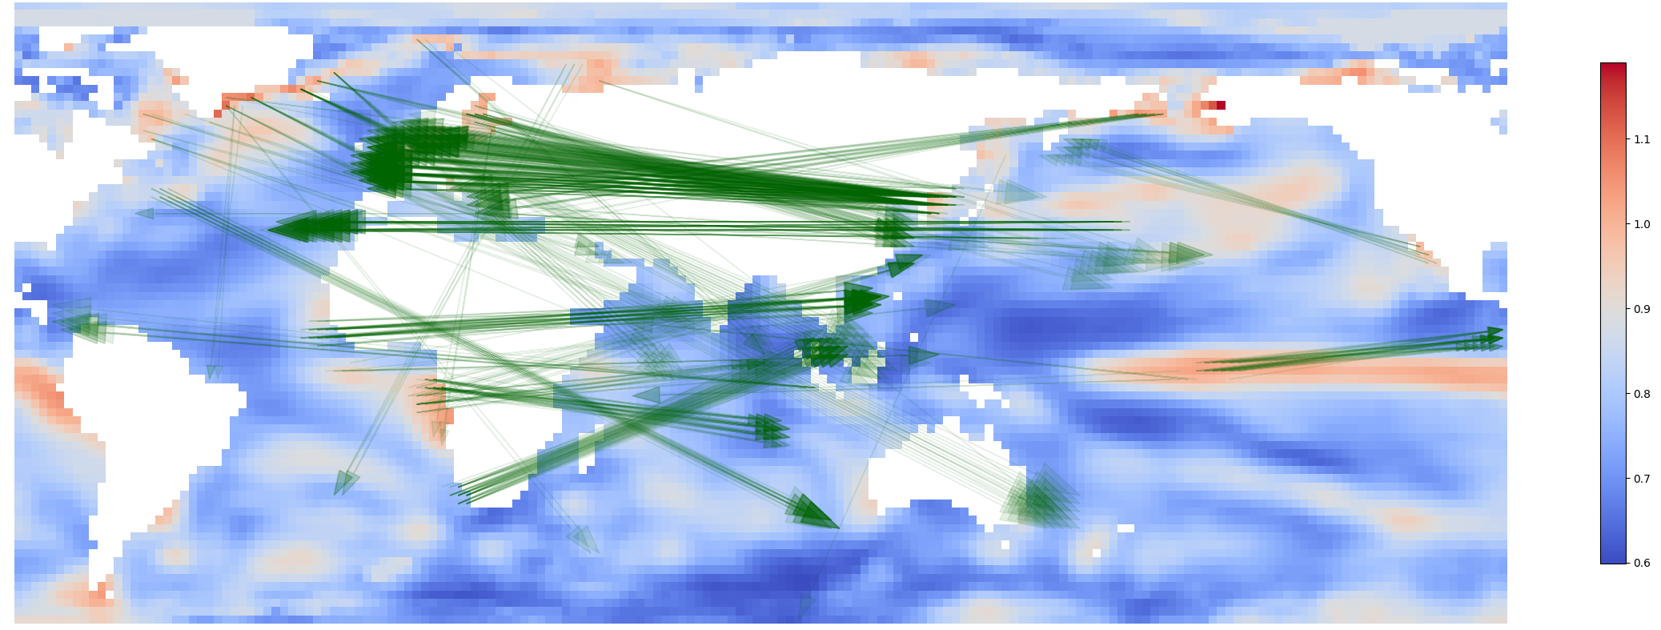
Flow analysis
Result
Top 500 of all connections over 7000km
Macro flows: West coast of Africa →Southeast Asia, Northeast Asia → Western Europe
Need for cross-validation with existing context on ocean current circulation

Slide 22
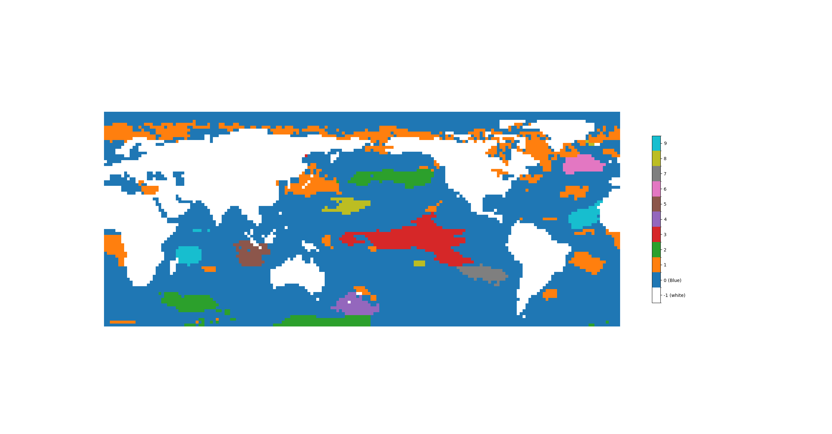
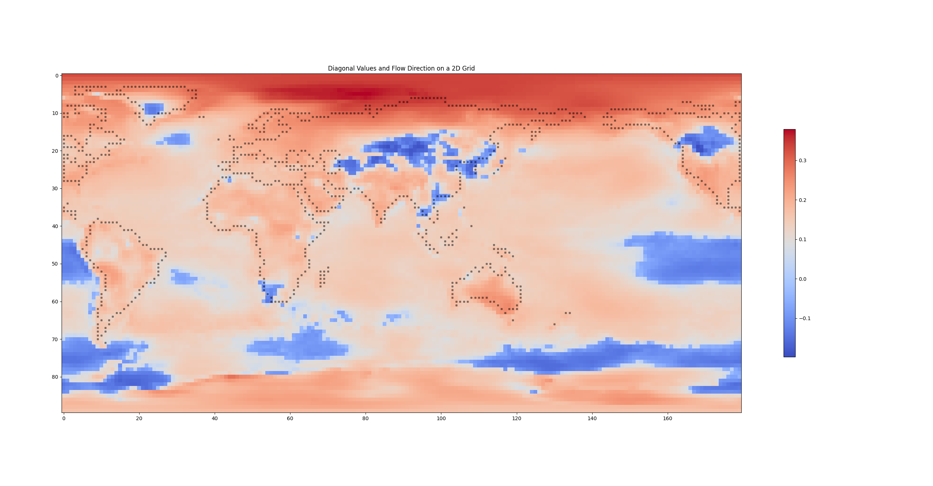
Teleconnection Phenomena in Climate Networks
Summary
Summary
Future Works
Teleconnection observation and analysis using sea surface temperature data
Extract macroscopic patterns from sea level data through PCA analysis
Analyzing correlations through generalized heat equations
Building a network of influence through time series data of temperature
Observe teleconnection patterns over distance
Observation of climate correlations through analysis of influence networks
Climate correlation analysis at various time scales ( >1 year)
Applying analytical methodologies to air temperature data
Comparison and integration of climate phenomena from atmospheric and ocean temperature
Apply other methodologies such as percolation and eigenvector analysis
This study was conducted with support from the LAMP project of the National Research Foundation of Korea.

